Slide 1

Predicting Tweet Reach
A case study of plastic pollution
By Viktoriya Shirochenkova

Slide 2
TWITTER
280 characters or less
Focused message
Calculating reach
Are certain tweets more successful in terms of reach?
Are specific words more powerful than others?
Notes:
Twitter employs a message size restriction of 280 characters or less which forces the users to stay focused on the message they wish to disseminate.

Slide 3
Data
29 accounts
85,000 tweets

Slide 4
How effective is the tweet?
Estimated Followers
Absolute Reach Score (sum of # of retweets + favorites divide by two)
Relative Reach Score (absolute score / estimated followers)
Notes:
Estimated followers - used “way back machine’ internet archive
Relative reach score is normalized data against the followers counts. The normalization is linear and to make data more intuitive I multiplied this score by 1000000

Slide 5
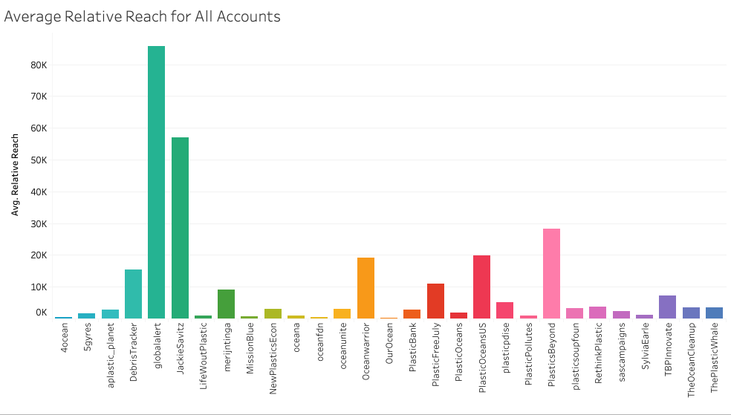
Notes:
Here we have average relative reach score for all accounts. We can see that some accounts like global alert and Jackie Savitz have a high relative reach score -- this means that their followers are more active (more retweets and more favorites) compared to other accounts.

Slide 6
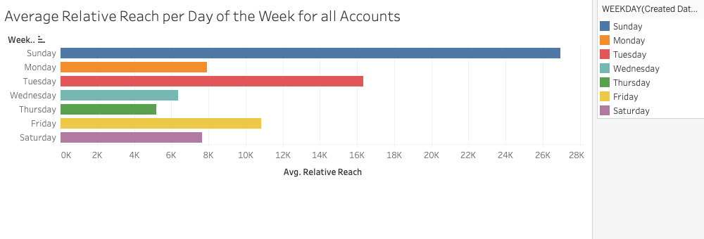
Notes:
Here we have average relative reach score per day of the week for all accounts. From this graph we can see that Sunday and Tuesday is a very busy twitter day.

Slide 7
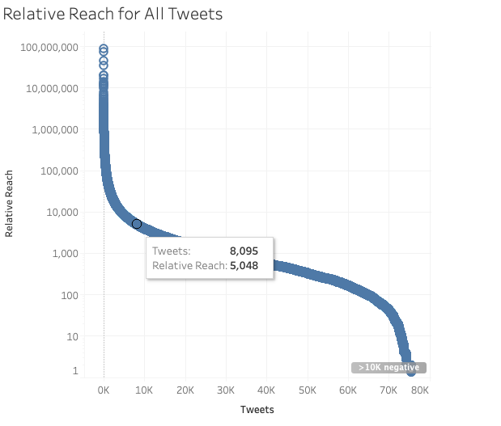
Notes:
Here we are looking at a relative reach score for roughly 80000 tweets. We make 2 observations: 1) the y-axis is on a log scale and 2) the tweets are sorted from the high relative reach score to the lower relative reach score. This graph shows a power distribution where a few tweets have a much higher relative reach than other tweets. I split the tweets into 2 classes: a score of above 5000 and a score of below 5000. Here you can see that only 8095 tweets belong to the above 5000 score category which is roughly 10% of all the tweets. Those 10% of the tweets have the highest reach.

Slide 8
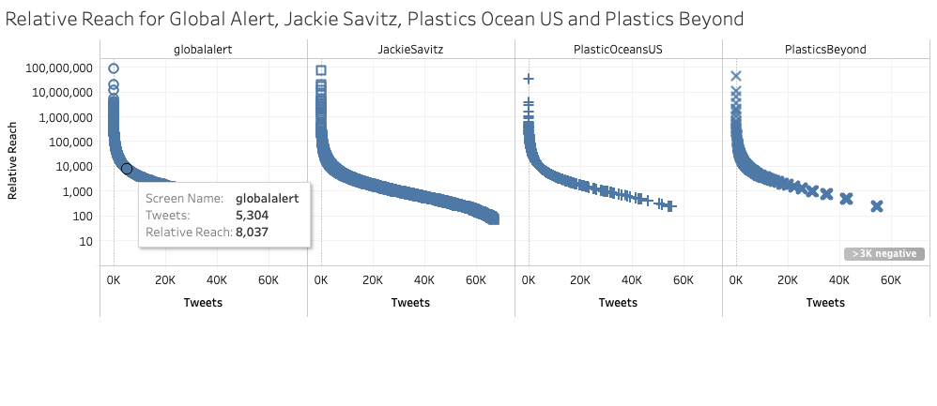
Notes:
Next we will look at the top 4 average relative reach score and again we see that roughly 10% of tweets (even less) fall into a relative reach score of above 5000.

Slide 9
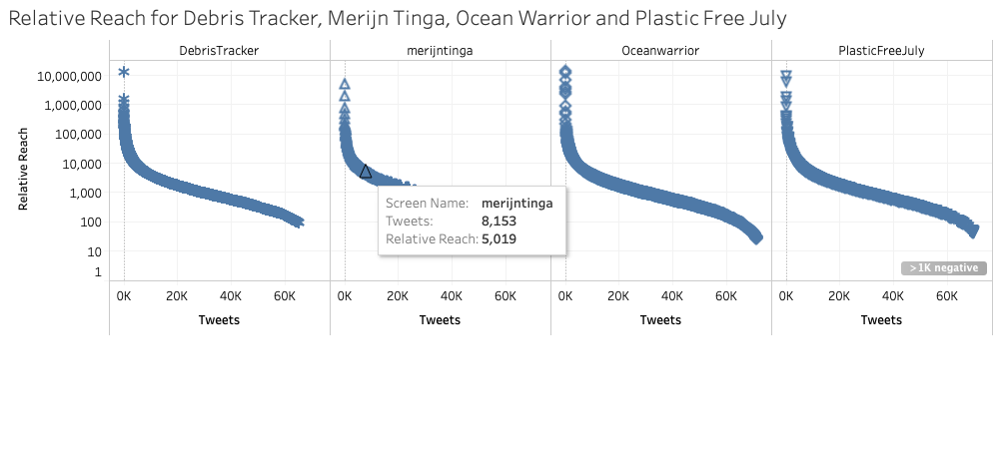
Notes:
On this slide I wanted to look at another 4 accounts to understand a pattern of how many tweets fall into above 5000 relative reach score. And again they follow the same power distribution. Roughly less than 10% of tweets fall above 5000 reach score and the remaining tweets fall into below 5000 reach score

Slide 10
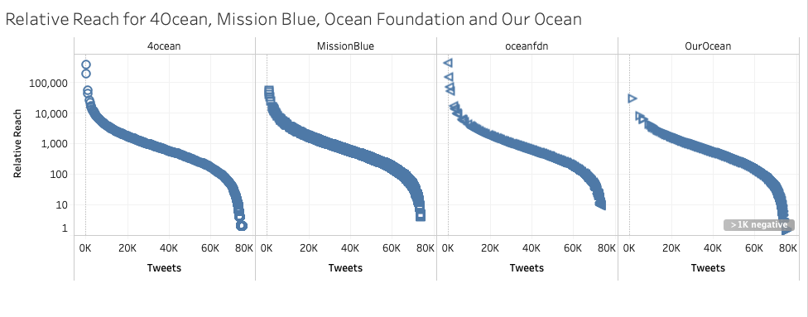

Slide 11
Word Analysis
Natural Language Processing
Clean, tokenize, stem, lemmatize & remove stopwords
List of words for each tweet
TF-IDF: Term Frequency-Inverse Document Frequency
Notes:
TF: Term Frequency - measures how frequently a word occurs in a corpus.
IDF: Inverse Document Frequency - how many times a word appears at least once in each document.
TF-IDF score is calculated by TF multiplied by IDF, measuring of how frequent a word is on a particular set of documents.
I calculated TF-IDF for each of the accounts on tweets that are above 5000 relative reach score and TF-IDF for each of the accounts that are below 5000.
I calculated TF-IDF score for the entire corpus.
Further, I calculated TF-IDF ratio by taking TF-IDF of above 5000 relative reach score divided by below 5000 relative reach score. A score of 1 means that the word is used equally on both above 5000 and below 5000. A score of above 1 means that the word is used more often in the tweets above 5000. If a score is below 1 than a word is used more often on the below 5000 relative reach score. If the score is 0 either the word is not used on the above 5000 relative score tweets or a word is not used at all in that particular corpus. If the score equals 10 it means an arbitrary score you put if a word is only on the above 5000 relative score group.

Slide 12
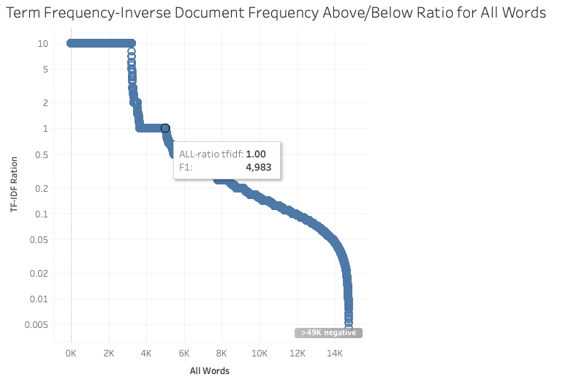
Notes:
On this graph I am using TF-IDF ratio for all unique words (60000) in the corpus. We can see a power distribution again but it is cut at value 10 due to our definition of an arbitrary score where the word is only in the above 5000 relative score group. We can see that than 10% have a ratio of 1 or above. This might be due that some words are only used on some accounts only.

Slide 13
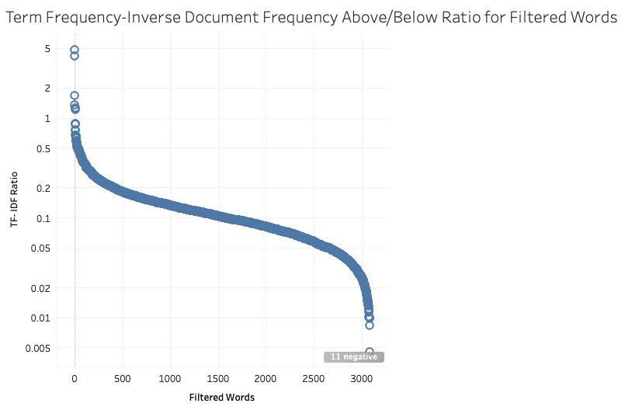
Notes:
I filtered the words keeping only those that are used at least once in at least 20% of the accounts which narrows it down to about 3000 words (roughly 5% of the total words). We can see that very few words have a score above 1 and majority of the words are below 5000 relative reach score.

Slide 14
Conclusion
Do some tweets have more reach than others?
Are specific words more powerful than others?
Further analysis
Notes:
Yes definitely does as we saw that from our power log when we looked at relative reach score for all tweets and across several accounts
Yes, we saw that also, most of the words with ratio higher than 1 are used in few or just one account. Is it a niche thing? Do certain account tailors words for very particular demographics? It is unclear and further research is needed.

